Slide 1

SDN Controller
Mininet Workshop

Slide 2
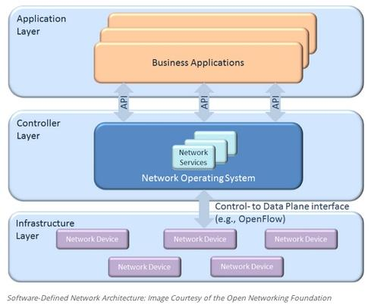
SDN Components

Slide 3
List of SDN Controllers
NOX
Beacon
Floodlight
Maestro
POX
Trema (Helios)
BigSwitch
SNAC

Slide 4
NOX
The first OpenFlow controller platform, NOX, was released in early 2008.

Slide 5
NOX
NOX is a Network Operating System that provides control and visibility into a network of OpenFlow switches.
It supports concurrent applications written in C++, plus includes a number of sample controller applications.
NOX is an open source development platform for software-defined network

Slide 6
NOX features
Provides a C++ OpenFlow 1.0 API
Includes sample components for:
Topology discovery
Learning switch
Network-wide switch

Slide 7
POX
POX is NOX‘s younger sibling. At its core, it’s a platform for the rapid development and prototyping of network control software using Python.

Slide 8
Cbench Latency Test (ms per flow)

Slide 9
Cbench TroughputTest (Flow per second)

Slide 10
Beacon
Beacon is an extensible Java-based OpenFlow controller.
Beacon is a fast, modular, Java-based OpenFlow controller that supports both event-based and threaded operation.

Slide 11
Beacon Key Features
Stable , Beacon has been in development since early 2010, and has been used in several research projects, networking classes, and trial deployments.
Rapid Development , Beacon is easy to get up and running. Java and Eclipse simplify development and debugging of your applications.
Fast , Beacon is multithreaded, check out performance benchmarks.
Web UI , Beacon optionally embeds the Jetty enterprise web server and a custom extensible UI framework.

Slide 12
Beacon Key Features
Open source , Beacon is licensed under a combination of the GPL v2 license and the Stanford University FOSS License Exception v1.0.
Cross-platform , Beacon is written in Java and runs on many platforms, from high end multi-core Linux servers to Android phones.

Slide 13
Latency: Single thread

Slide 14
Floodlight
The Floodlight controller is Java-based OpenFlow Controller. It was forked from the Beacon controller, originally developed by David Erickson at Stanford.
The Floodlight Open SDN Controller is an enterprise-class, Apache-licensed, Java-based OpenFlow Controller.

Slide 15
Floodlight
Floodlight is designed to work with the growing number of switches, routers, virtual switches, and access points that support the OpenFlow standard.
It is supported by a community of developers including a number of engineers from Big Switch Networks.

Slide 16
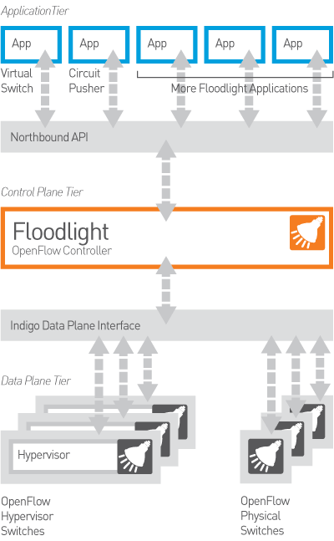
Floodlight

Slide 17
Floodlight Feature Highlights
Offers a module loading system that make it simple to extend and enhance.
Supports a broad range of virtual and physical OpenFlow switches .
Support for OpenStack cloud orchestration platform.
Easy to set up with minimal dependencies.

Slide 18
Trema(Helios)
Trema is a OpenFlow controller framework Open source, Developed by NEC Research Lab.
Modular extensible architecture

Slide 19
Trema Supported Platforms
Trema supports GNU/Linux only.
It has been tested on the following environments:
Ruby 1.8.7 or higher
RubyGems 1.3.6 or higher
Ubuntu 13.04, 12.10, 12.04, 11.10, and 10.04 (i386/amd64, Desktop Edition)
Debian GNU/Linux 7.0 and 6.0 (i386/amd64)
Fedora 16-19 (i386/x86_64)
It may also run on other GNU/Linux distributions but is not tested and NOT SUPPORTED at this moment.

Slide 20
Trema Protocols
Trema currently supports OpenFlow version 1.0 only.

Slide 21
Maestro
Maestro is an extensible Java-based OpenFlow controller released by Rice University.
It has support for multi-threading and targets researchers.

Slide 22
SNAC
Open source OpenFlow controller with graphical user interface
Uses a web-based policy manager to manage the network
It is a module of NOX and requires appropriate version of NOX

